Slide 1
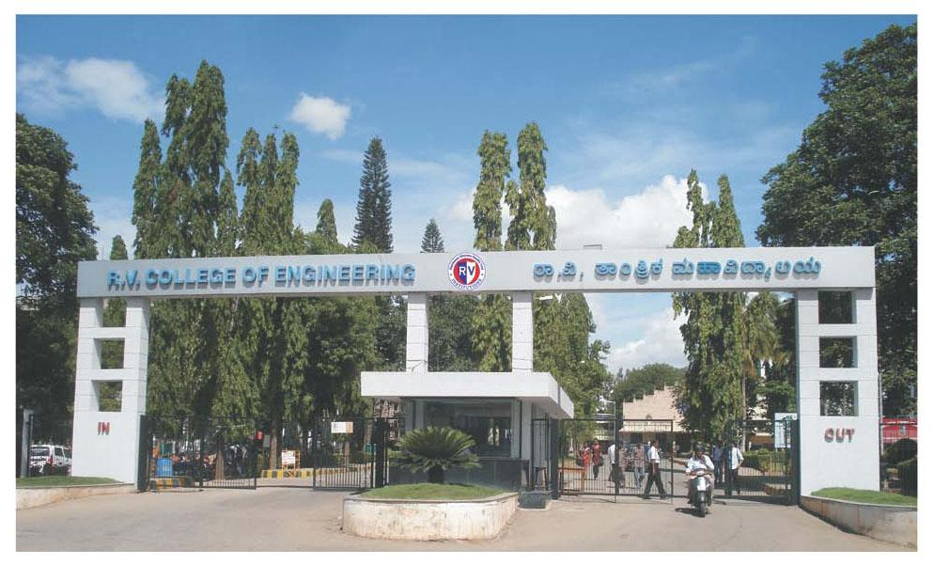
INTERDISCIPLINARY PHASE-3
Topic : Real Time Cashew Kernel Classification using Deep Learning
Internal Guide
Dr. Veena Devi S .V
Associate Professor
Department of Electronics & Communication Engineering

Slide 2
Team ID 190
Program | USN | Name
ECE | 1RV23EC408 | RAVIKANT
ECE | 1RV23EC410 | SAGAR T NAYAK
BT | 1RV23BT404 | YOGEESH A S
CSE | 1RV23CS405 | KIRAN H R
CSE | 1RV23CS407 | MANOJ KUMAR B V
Internal Guide
Dr. Veena Devi S .V
Associate Professor
Department of Electronics & Communication Engineering

Slide 3
Problem Statement and Objectives
Problem Statement:
To develop an efficient and scalable cashew segregation system that can accurately classify cashew kernels according to their respective grades, overcoming challenges related to real-time processing, image quality, hardware limitations, defect detection, and dataset constraints.
Objectives:
✅ Develop an image processing system to capture raw cashew kernel images and perform data preprocessing.
✅ Design and implement algorithms for feature extraction, data analysis, and classification of kernel variations.
✅ Apply AI techniques to accurately detect, classify, cashew kernels.
✅ Integrate reliable hardware and software components for efficient, real-time testing and grading.

Slide 4
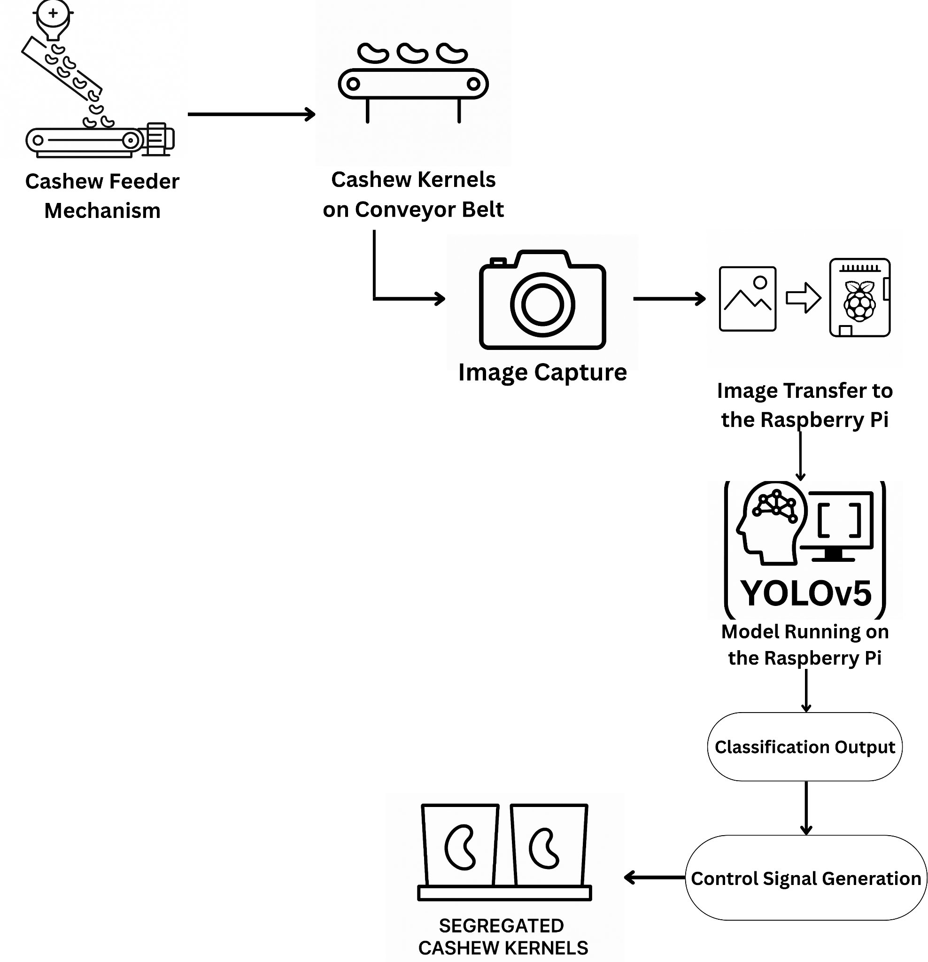
Block Diagram/Methodology
Fig. Methodology

Slide 5
Incorporation of Phase 1 & 2 Suggestions
Based on feedback from Phases 1 and 2, improvements were suggested to handle situations where multiple cashew kernels appeared grouped together, which could affect detection and sorting accuracy.
To address this, the system was enhanced with:
A custom-built feeder mechanism designed to release one cashew kernel at a time in a controlled manner.
This feeder leads to a secondary conveyor belt, ensuring isolated kernel flow.
The primary conveyor setup, which was already integrated with a webcam and flap-based sorting system, performs:
Real-time image capture and classification of each kernel,
Followed by automated actuation of flaps to direct kernels into the correct bins based on grade.
This staged feeding and classification approach significantly improved the system’s accuracy, consistency, and sorting reliability, fully addressing the suggestions received in earlier phases.

Slide 6
Tools & Techniques
Python :
Core Model Development And Image Processing Task.
OpenCV :
For image preprocessing, enhancement, and feature extraction(grades is size,Bounding box dimensions Aspect ratio (width vs height), sharp).
Albumentations:
A fast and flexible Python library used to apply image augmentations like rotation, flipping, brightness changes, and noise to improve model robustness.
Annotation Tool Used
Platform: Roboflow
Annotation Type: Bounding Boxes
Export Format: YOLO v5 (.txt) format
Annotation Method: Manual drawing with class labels.

Slide 7
Tools & Techniques
5. Raspberry Pi 4 :
Compact single board computer used to run the model and to control hardware.
6. Web Cam(Microsoft lifecam):
Used for Data Acquisition and also for capturing real time video for cashew grading.
7. Arduino Uno:
Used to drive the motors for both conveyor belt and the actuators.
8. Stepper Motor and Motor Drivers(L298N)
Used to drive the conveyor belt setup and Sorting Flaps to direct the kernel to the respective bins.

Slide 8
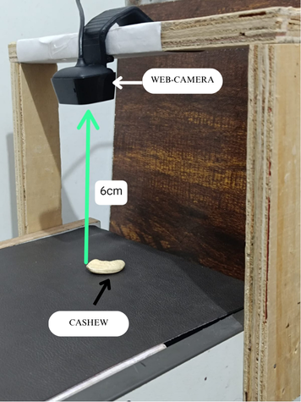
Work Progress so far
Dataset Development
Captured a substantial number of cashew kernel images using Microsoft Lifecam in varied lighting and orientations.
Images Captured
GRADES | NO. OF IMAGES | RESOLUTION
W180 | 474 | 1280X800
W300 | 471 | 1280X800
W500 | 473 | 1280X800

Slide 9
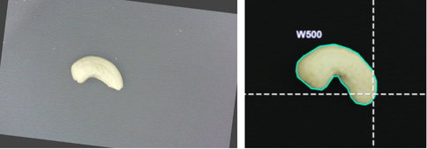
Work Progress so far
2. Image Preprocessing:
Initial preprocessing steps such as:
resizing ( resized to 640x640)
noise reduction
image enhancement
Data Augmentation
have been implemented to improve the quality of input data for Model Training .

Slide 10
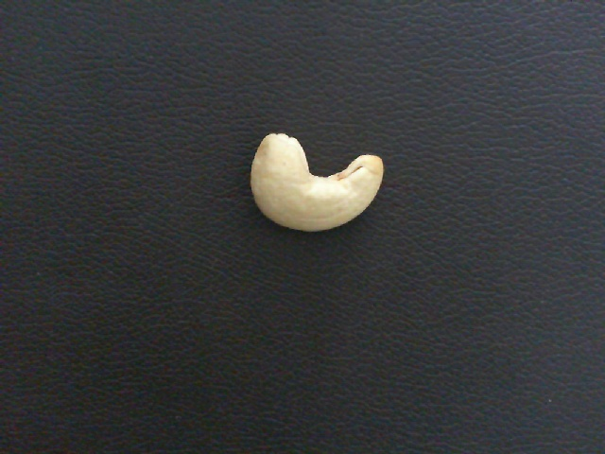

Work Progress so far
Noise Reduction
To enhance image quality and minimize unwanted artifacts, noise reduction was performed using the Gaussian filtering algorithm.
It applies a Gaussian function (a bell-shaped curve) to blur the image.
This is done by averaging each pixel's value with its neighbors, with closer pixels weighted more heavily.
It effectively removes high-frequency noise (random variation in brightness or color).

Slide 11
Work Progress so far
Image Enhancement:
it used to improve the visual quality of an image or make certain features more distinguishable for further analysis.
It helps in making key features (like cracks, textures, or object boundaries) more visible and easier to detect, especially in applications like cashew grading, medical imaging, or surveillance.

Slide 12
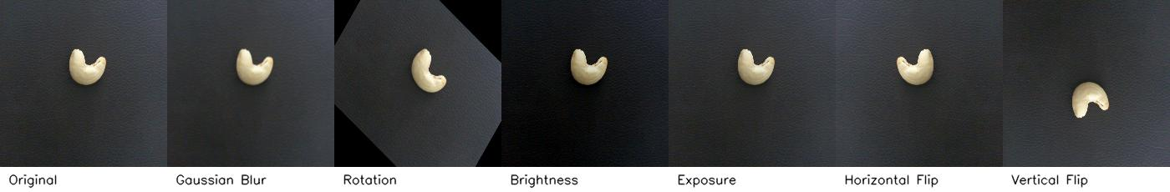
Work Progress so far
Augmentation Settings
Techniques Applied:
💧 Blur: Gaussian blur applied up to 5 pixels
🔁 Rotation: Random angle between -45° to +45°
💡 Brightness: Adjusted randomly between -25% to +25%
🌗 Exposure: Adjusted between -10% to +10%
🔄 Flip: Horizontal, Vertical
After Augmentation
Grades | No. of Images | Resolution
W180 | 1891 | 640 x 640
W300 | 1892 | 640 x 640
W500 | 1890 | 640 x 640

Slide 13
Work Progress so far
After dataset augmentation, the model was trained under the following configuration to ensure optimal detection performance:
Image Size: 640 × 640
Epochs: 100
Batch Size: 16
Learning Rate: 0.01
Model Used: YOLOv5s

Slide 14
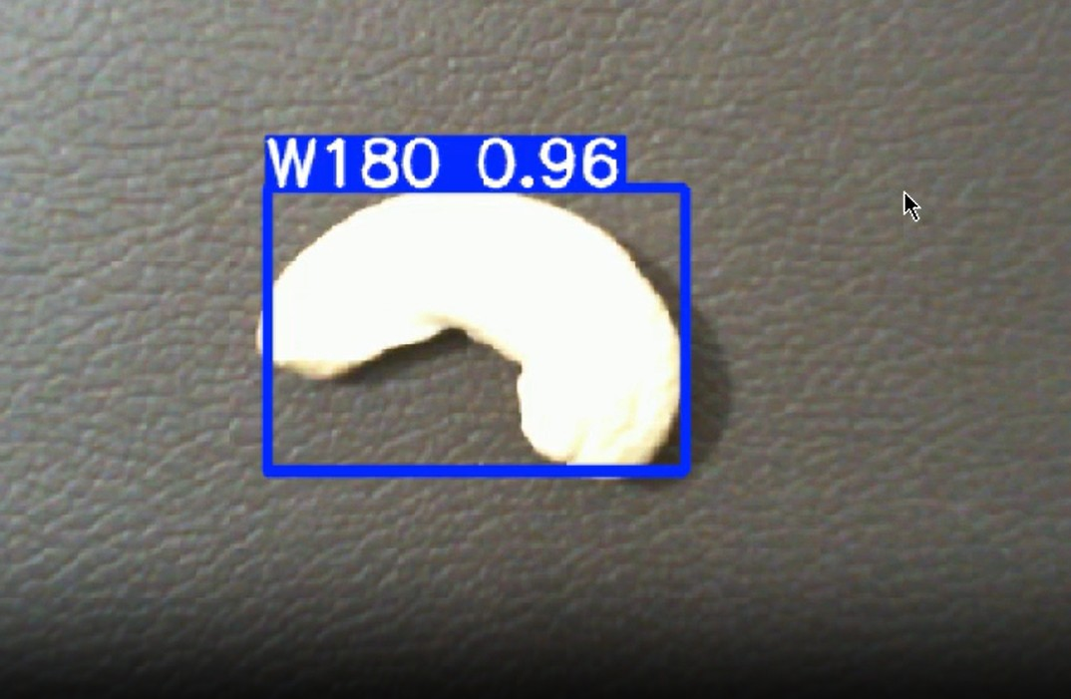
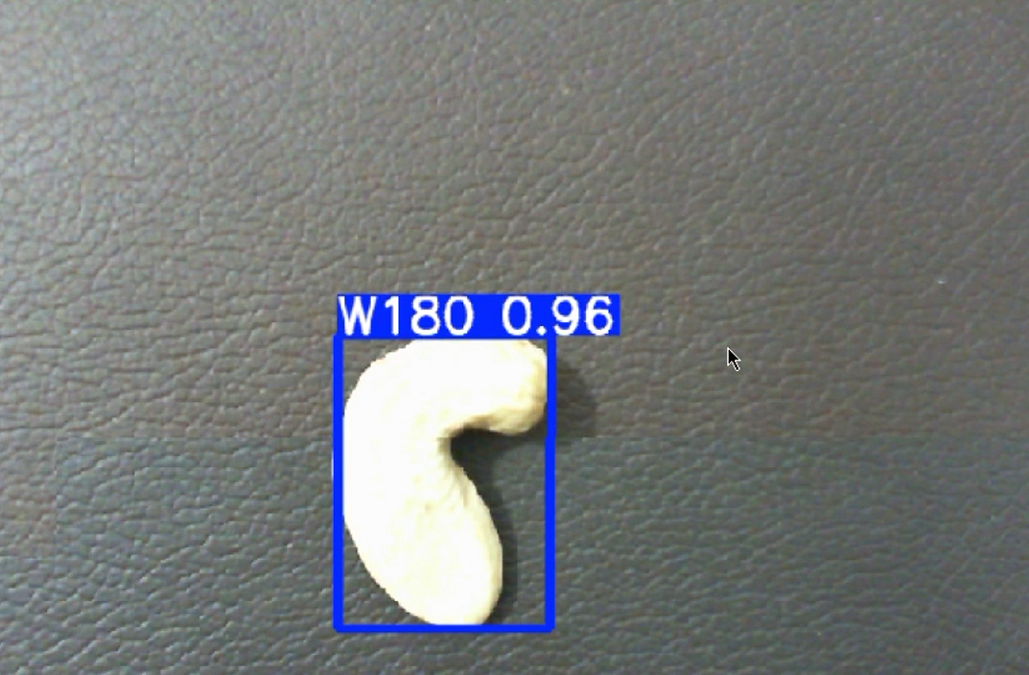
Partial Results

Slide 15
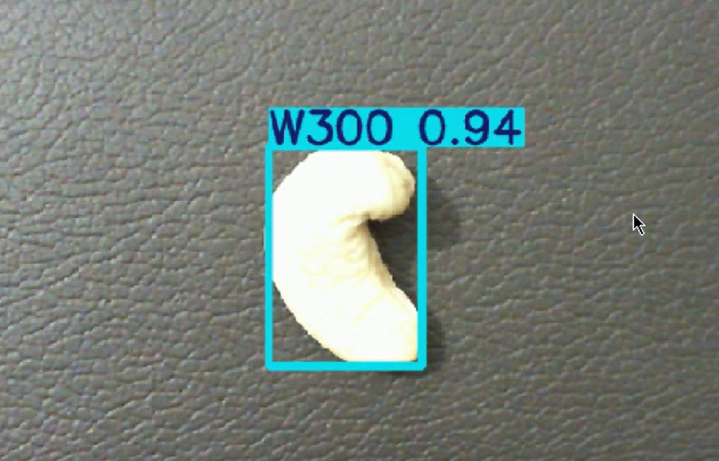
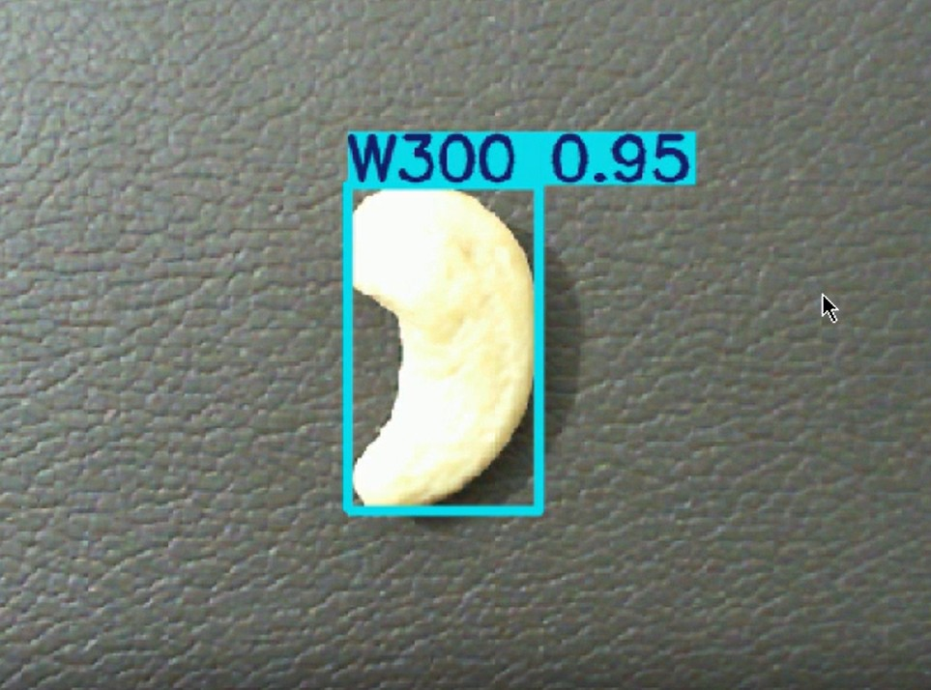
Partial Results

Slide 16
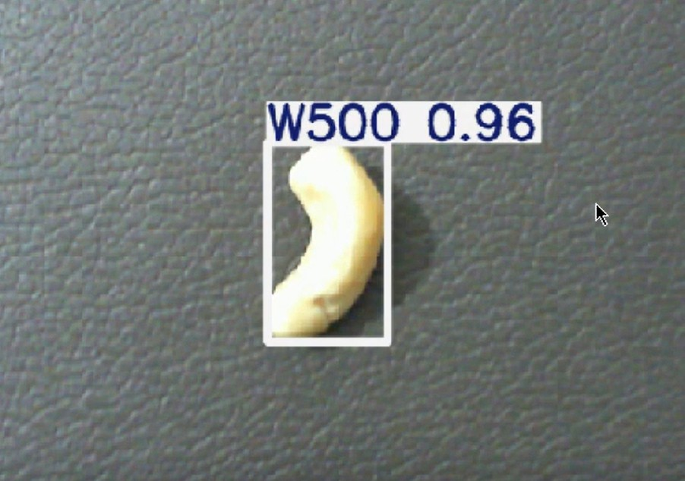
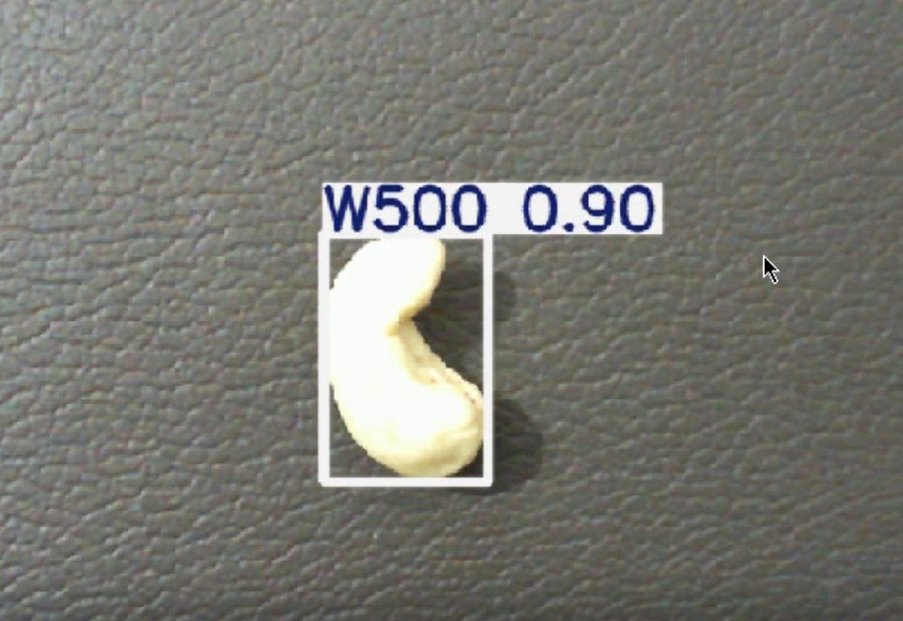
Partial Results

Slide 17
Partial Results
A YOLOv5 model has been trained on the dataset, achieving high detection accuracy across all three classes.
The trained model demonstrates strong performance in identifying individual kernels under controlled lighting and camera conditions.
Intermediate validation using test images and video streams shows reliable detection with clear bounding boxes and confidence scores.
Results confirm that the model is ready for integration with real-time hardware and further system components.

Slide 18
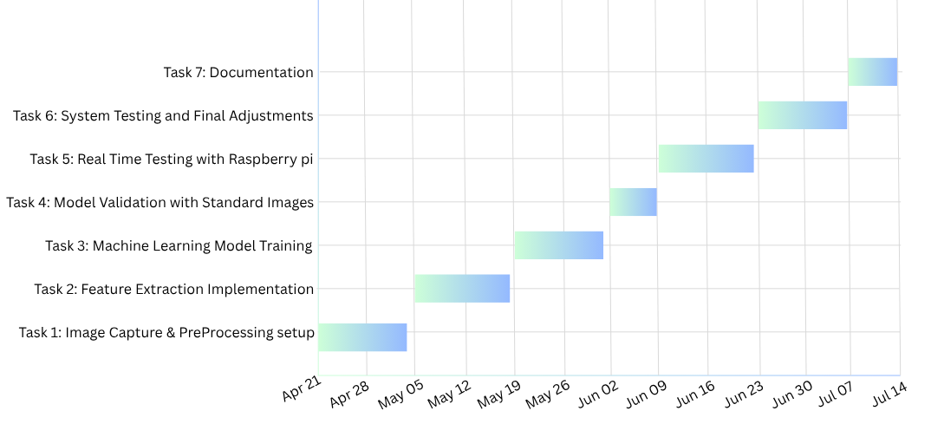
TIMELINE

Slide 19
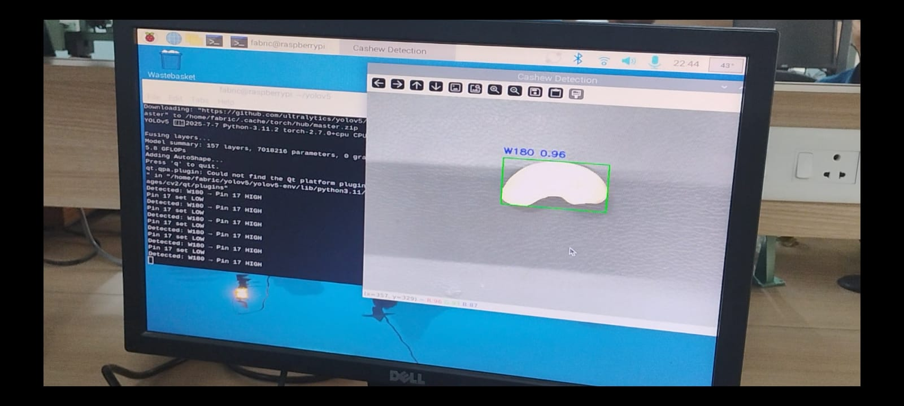
Results & Discussion
The Raspberry Pi desktop is running the YOLOv5s cashew classification program.
The right side of the screen shows live detection output, a cashew kernel identified as W180 with 96% confidence, enclosed in a green bounding box.
Model Predicting the accurate inference

Slide 20
Results & Discussion
Model Performance Evaluation
mAP@0.5: 98.9%
Precision: 93.6%
Recall: 93.2%
F1 Score: 96.4%
These metrics reflect high performance in detecting and classifying cashew kernel grades (W180, W300, W500) under varied lighting and placement conditions. The model demonstrated strong generalization and balance between precision and recall.

Slide 21
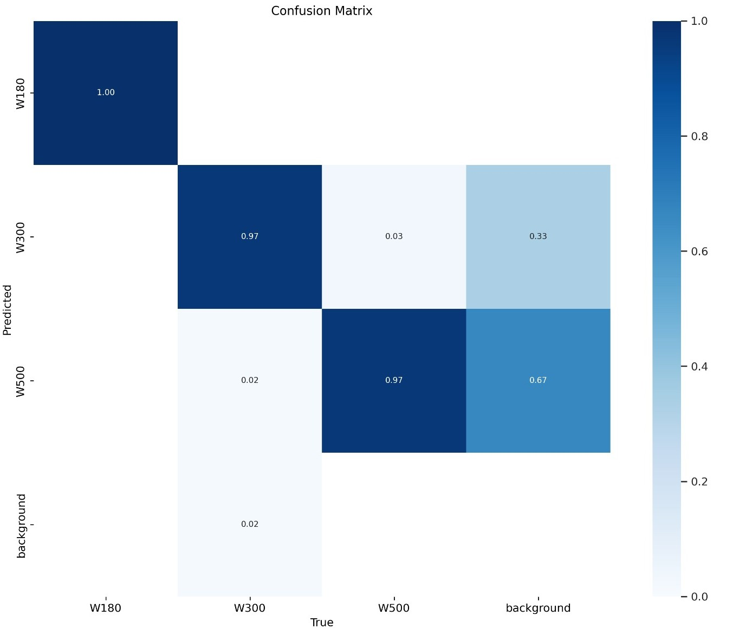
Results & Discussion
Confidence and Precision - Recall Analysis
The confusion matrix illustrates clear and balanced classification across all three kernel grades: W180, W300, and W500.
Diagonal dominance in the matrix confirms high true positive predictions for all classes.
Minor confusion observed:
A few W300 kernels misclassified as W500, likely due to close visual similarity in size/shape.
Overall distribution remains well-separated, reflecting good inter-class distinction by the model.
This analysis confirms the model’s robustness in multi-class detection tasks with minimal class confusion.
Fig. Confusion Matrix

Slide 22
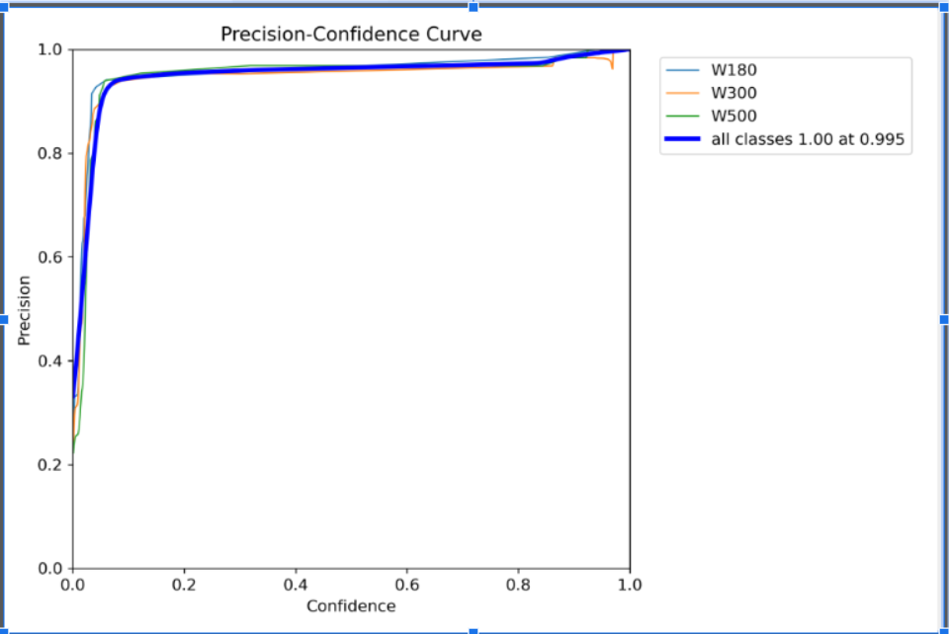
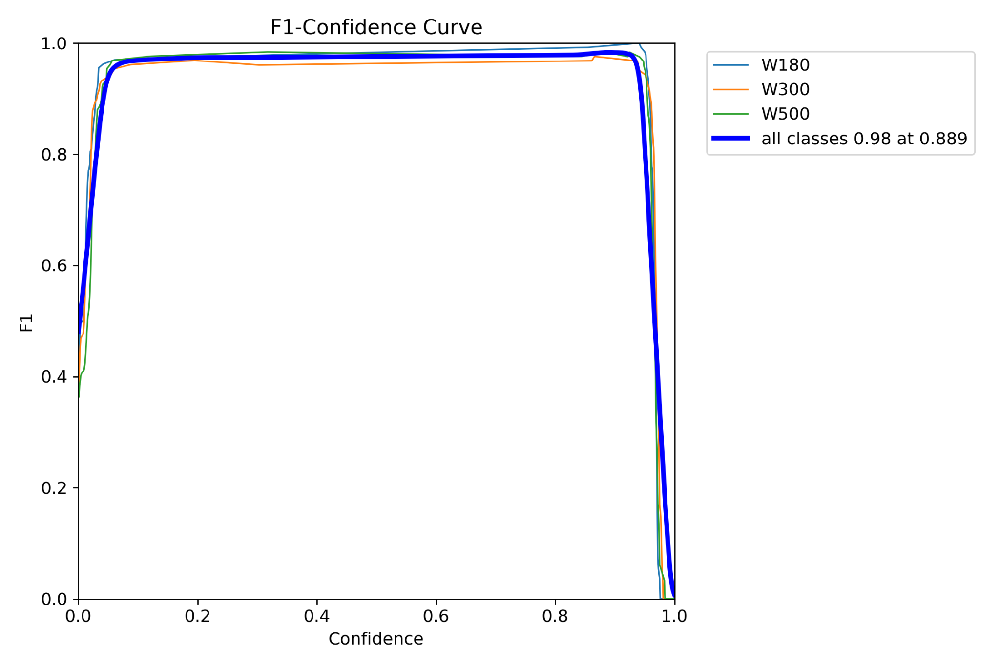
Results & Discussion
Confidence and Precision Recall Analysis
Fig. Precision - Confidence Curve
Fig. F1 - Confidence Curve

Slide 23
Results & Discussion
Confidence and Precision - Recall Analysis
F1–Confidence Curve:
Peaks at a confidence threshold of 0.89, achieving an F1 Score close to 0.98.
Indicates optimal balance between precision and recall at that threshold.
Precision–Confidence Curve:
Shows near-perfect precision (~1.00) at a threshold of 0.995.
Indicates very low false positives at high confidence levels.
Recall–Confidence Curve:
Recall remains above 0.90 until confidence reaches 0.93.

Slide 24
Results & Discussion
The trained YOLOv5s model was deployed on a Raspberry Pi 4, integrated with:
USB webcam for image capture
Arduino Uno for motor control
Stepper motors and flaps for physical sorting
Observations:
Sorting errors were minimal and mainly due to:
Motion blur
Slight delay in actuation timing

Slide 25
Conclusion
Results Achieved
Achieved high model accuracy in classifying cashew kernel grades using the YOLOv5s architecture on a custom-trained dataset.
Enabled smooth and consistent live classification on embedded hardware (Raspberry Pi).
Successfully integrated the detection system with Arduino-based actuators to perform automated kernel sorting.
Reduced manual effort and improved sorting speed compared to traditional hand grading methods.

Slide 26
Conclusion
Limitations
Accuracy may drop under inconsistent lighting.
Currently limited to a small number of kernel grades.
Sorting mechanism uses a fixed bin layout and lacks adaptability.
No remote monitoring or cloud connectivity is implemented.
Relies on consistent kernel spacing for reliable operation.
Future Work
Expand model to support additional kernel types.
Upgrade to faster edge hardware for improved processing speed.
Enable cloud-based monitoring and system updates.

Slide 27

QR Code for Video Demo and PPT

Slide 28
REFERENCES
[1]. A. M. O. Arun, G. N. Aneesh, and A. Shyna, “Automated cashew kernel grading using machine vision,” in Proc. Int. Conf. Next Generation Intelligent Systems (ICNGIS), 2018, pp. 1–6. doi: 10.1109/ICNGIS.2016.7854063.
[2]. A. Shyna and R. M. George, “Machine vision based real time cashew grading and sorting system using svm and back propagation neural network,” in Proc. Int. Conf. Circuits Power and Computing Technologies (ICCPCT), 2017, pp. 1–4. doi: 10.1109/ICCPCT.2017.8074385.
[3]. A. Sivaranjani, S. Senthilrani, B. Ashokumar, and A. S. Murugan, “An improvised algorithm for computer vision based cashew grading system using deep cnn,” in Proc. IEEE Int. Conf. Current Trends in Advanced Computing (ICCTAC), 2019, pp. 1–6.
[4]. A. Sivaranjani, S. Senthilrani, B. Ashokumar, and A. S. Murugan, “Cashnet-15: An optimized cashew nut grading using deep cnn and data augmentation,” in Proc. Int.Conf. Systems Computation Automation and Networking (ICSCAN), 2019, pp. 1–6
[5]. V.-N. Pham, Q.-H. D. Ba, D.-A. T. Le, Q.-M. Nguyen, D. D. Van, and L. Nguyen, “Alow-cost deep-learning-based system for grading cashew nuts,” Computers, vol. 13, no. 3, p. 71, 2024.
[6]. S. N. Karnam, V. S. Vaddagallaiah, P. K. Rangnaik, A. Kumar, C. Kumar, and B. M. Vishwanath, “Precise cashew classification using machine learning,” Engi neering, Technology & Applied Science Research, vol. 14, no. 5, pp. 17414–17421, 2024. doi: 10.48084/etasr.8052.
[7]. M. A. and P. N. Renjith, “Classification of durian fruits based on ripening with machine learning techniques,” in Proc. Int. Conf. Intelligent Sustainable Systems (ICISS), 2020, pp. 542–547.

Slide 29
REFERENCES
[8]. S. E. Sunday, R. Ji, A. N. Abdalla, and H. Bian, “Fruit image classification using the inception-v3 deep learning model,” in Proc. Int. Conf. Cognitive Computing and Complex Data (ICCD), 2023, pp. 227–230. doi: 10.1109/ICCD59681.2023. 10420760.
[9]. V. Gautam, R. G. Tiwari, A. Misra, D. Witarsyah, N. K. Trivedi, and A. K. Jain, “Dry fruit classification using deep convolutional neural network trained with trans fer learning,” in Proc. Int. Conf. Advancement in Data Science, E-learning and In formation System (ICADEIS), 2023, pp. 1–6. doi: 10.1109/ICADEIS58666.2023. 10270982.
[10]. R. Raj, S. S. Nagaraj, S. Ritesh, T. A. Thushar, and V. M. Aparanji, “Fruit classi f ication comparison based on cnn and yolo,” in IOP Conf. Ser.: Mater. Sci. Eng., vol. 1187, 2021, p. 012031.
[11]. P. Nirale and M. Madankar, “Analytical study on iot and machine learning based grading and sorting system for fruits,” in Proc. Int. Conf. Computational Intel ligence and Computing Applications (ICCICA), 2021, pp. 1–6. doi: 10.1109/ ICCICA52458.2021.9697161.
[12]. R. Rico, M. Bullo, and J. Salas-Salvado, “Nutritional composition of raw fresh cashew (anacardium occidentale l.) kernels from different origin,” Food Science & Nutrition, vol. 4, no. 2, pp. 329–338, 2015.
[13]. T. Akinhanmi, V. Atasie, and P. Akintokun, “Chemical composition and physic ochemical properties of cashew nut (anacardium occidentale) oil and cashew nut shell liquid,” Journal of Agricultural, Food and Environmental Sciences, vol. 2,no. 1, pp. 1–10, 2008.
[14]. D. Balasubramanian, “Postharvest technology: Physical properties of raw cashew nut,” Journal of Agricultural Engineering Research, vol. 78, no. 3, pp. 291–297, 2001.

Slide 30
REFERENCES
[15]. J. Tyman, R. Johnson, M. Muir, and R. Rokhgar, “The extraction of natural cashew nut shell liquid from the cashew nut (anacardium occidentale),” J. Am. Oil Chemists’ Soc., vol. 66, no. 4, pp. 553–557, 1989
[16]. S. K.G.Srivastava and V. Meharwade, Cashew Handbook 2014– Global Perspective. 2014.
[17]. T. T. F. Saeed, H. Bader, B. Niaz, M. A. Fzaal, A. Din, and H. A. R. Suleria, “Cashew nut allergy: Immune health challenge,” Trends in Food Science & Tech nology, vol. 86, pp. 209–216, 2019.
[18]. B. Gon¸calves et al., “Composition of nuts and their potential health benefits—an overview,” Foods, vol. 12, p. 942, 2023. doi: 10.3390/foods12050942.
[19]. R. Singh, P. Karthikeyan, and R. Anand, “Sc3t: A low-cost transformer-enhanced deep learning architecture for real-time cashew kernel grading on edge devices,” Computers and Electronics in Agriculture, vol. 215, p. 108274, 2024. doi: 10. 1016/j.compag.2024.108274
[20]. A. Mishra and S. Awasthi, “Hybrid deep learning and svm model for grading of cashew kernels using resnet-50 features,” Journal of Food Engineering, vol. 349, p. 111395, 2024. doi: 10.1016/j.jfoodeng.2024.111395.
[21]. Y. Li, H. Zhou, and J. Wang, “Lightweight shape-based svm classifier for whole and split cashew kernel detection,” Journal of Imaging, vol. 9, no. 11, p. 198, 2023. doi: 10.3390/jimaging9110198.

Slide 31


